Slide 1

Lecturers in Dialogue (LID)

Slide 2
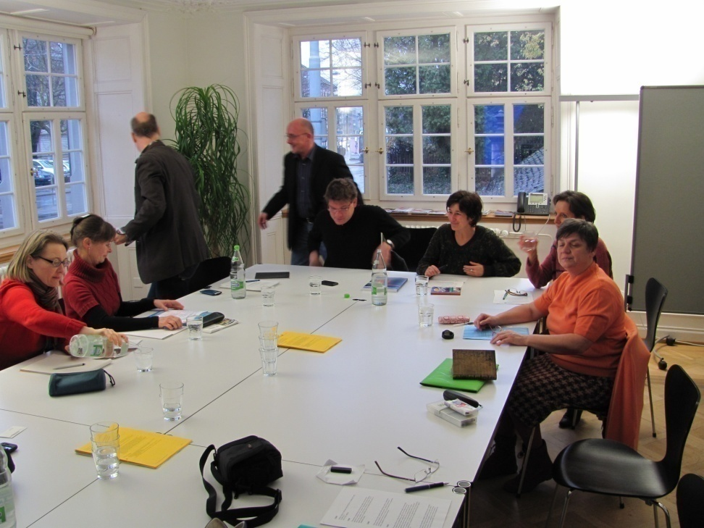
November 2010 - Zurich University of Teacher Education (Pädagogische Hochschule Zürich [PHZH])
Topic:
Multiculturalism and the potential of shadow play in working with preschool children
Participants :
Stevan Divjakovic, Jovanka Ulic, Vesna Colic, Stefanie Bieri, Radmila Blickenstorfer, Kai Felkendorff, Susan Guerber, Mathis Kramer, Sibylle Künzli, Sabrina Marruncheddu, Dominik Roost, Beatrix Zumsteg

Slide 3
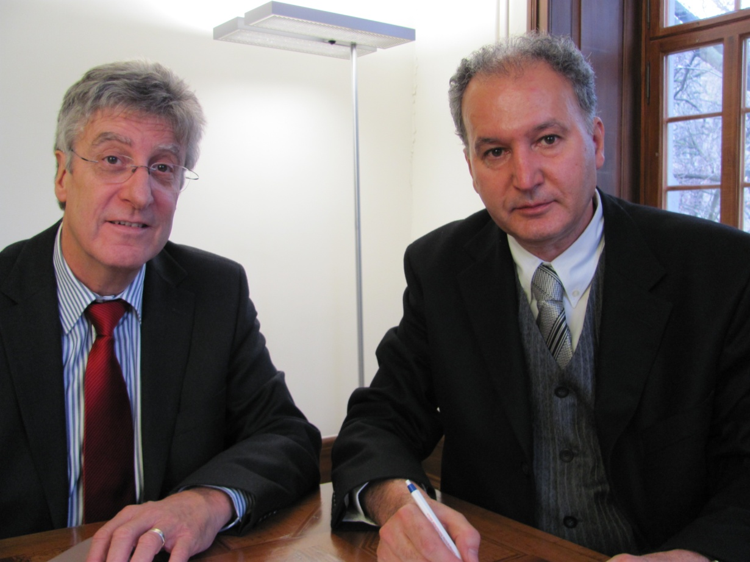
The signing of a cooperation agreement between the Zurich University of Teacher Education and the Preschool Teacher Training College (PTTC).

Slide 4
HISTORY OF COOPERATION
Coordinated in June 2010 in Novi Sad, revised in July 2010 in Zurich, the Cooperation Agreement has been signed in November 2010
In June 2010 under the auspices of the program titled "Partnership between North and South“, run by the Swiss Foundation for Education and Development, the Zurich University of Teacher Education (PHZH) and the Office of its Centre for International Projects in Education (PHZH / MPO), together with the Preschool Teacher Training College, began academic exchange oriented towards the realization of projects within a period of two years, with the aim of establishing mutual long-term partnerships.

Slide 5
OBJECTIVES OF THE PROJECT
  teaching the social values of a multicultural and a multilingual lifestyle to preschool and school children;
  adopting a value system based on human rights, social justice and sustainable development;
  dealing with the phenomenon of globalization from the standpoint of the education in early childhood, in order to make it easier for children to better understand the implications of globalization for their own lives and education;
  possibilities in meeting the said objectives by means of the traditional Eastern European shadow play as an art form;
  the complex task of educating the teachers involved with preschool and school children on the educational values of shadow play;
  the task of providing future preschool teachers exhaustive practical knowledge needed for producing shadow play performances as an applicable teaching resource, using the materials readily-available in the classroom;
  collecting the research results related to the topics relevant to pedagogy and practice in the field of shadow play performances;
  general academic exchange of experiences in specific areas, as well as didactic techniques between experts from both universities.

Slide 6
WORKSHOPS - LECTURERS IN DIALOGUE
SHADOW PLAY AS A PRODUCT OF COOPERATION

Slide 7
LECTURERS IN DIALOGUE
- workshops that were held during 2011, 2012, 2013 and 2014
Participants from PTTC
Topic :
mr Stevan Divjaković, mr Jovanka Ulić, dr Ivana Ignjatov Popović, dr Vesna Colić, mr Iboly Gera, dr Sanja Nišević, dr Lada Marinković, dr Svetlana Lazič, Dunja Cigić MA, Mirjana Matović MA, dr Bojan Milošević, Otilia Velišek Braško MA
Multiculturalism
The curricula of schools and kindergarten curricula
Students’ practice
Competencies and their relationship to the subjects
Inclusion
Lifelong learning
Children and the culture of education - ethnographic research performed at the school
Shadow Play
EDC / HRE

Slide 8
in March 2011 a conference titled "Partnership North - Southeast: How This Form of Cooperation Contributes to the Educational Process of Teachers and Preschool Teachers" was held in the organization of the Swiss Foundation for Education and Development, in which Beatrix Zumsteg, Michelle Swann and Sabrina Marruncheddu took part on behalf of PHZH, while Ivana Ignjatov Popović and Jovanka Ulić represented the shadow play project, this beeing a part of the joint project between PHZH and VSOV within the "Lecturers in Dialogue" framework.

Slide 9
Within the "Lecturers in Dialogue" framework, and thanks to the engagement of our teachers, professor dr Judith Hollenweger held a seminar in 2011 titled "International Classification of Functioning, Disability and Health, a Version Intended for Children and Youth (ICF-CY, WHO 2007) and Education", as well as a lecture titled "ICF - a Model for Integrating Different Standpoints", as part of a scientific meeting titled "Education and Communication for Inclusive Community - Lecturers in Dialogue".

Slide 10


Slide 11
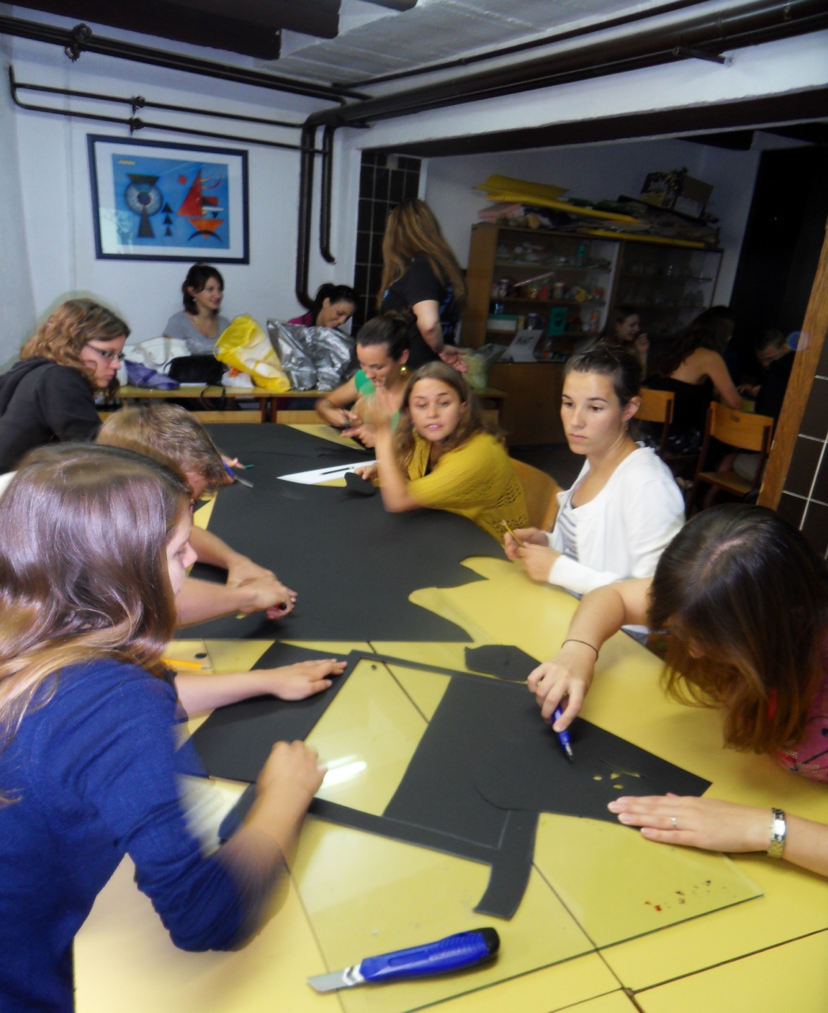
The framework of cooperation between our two universities includes the regular annual visits of students and professors from PHZH to our school organized in September. On this occasion, students from both universities have the opportunity to meet and exchange knowledge and experiences about the culture, language and the education that they acquire in the course of their studies.

